Slide 1
Digestive and Respiratory System Revision

Slide 2
Cells to Body Systems

Slide 3
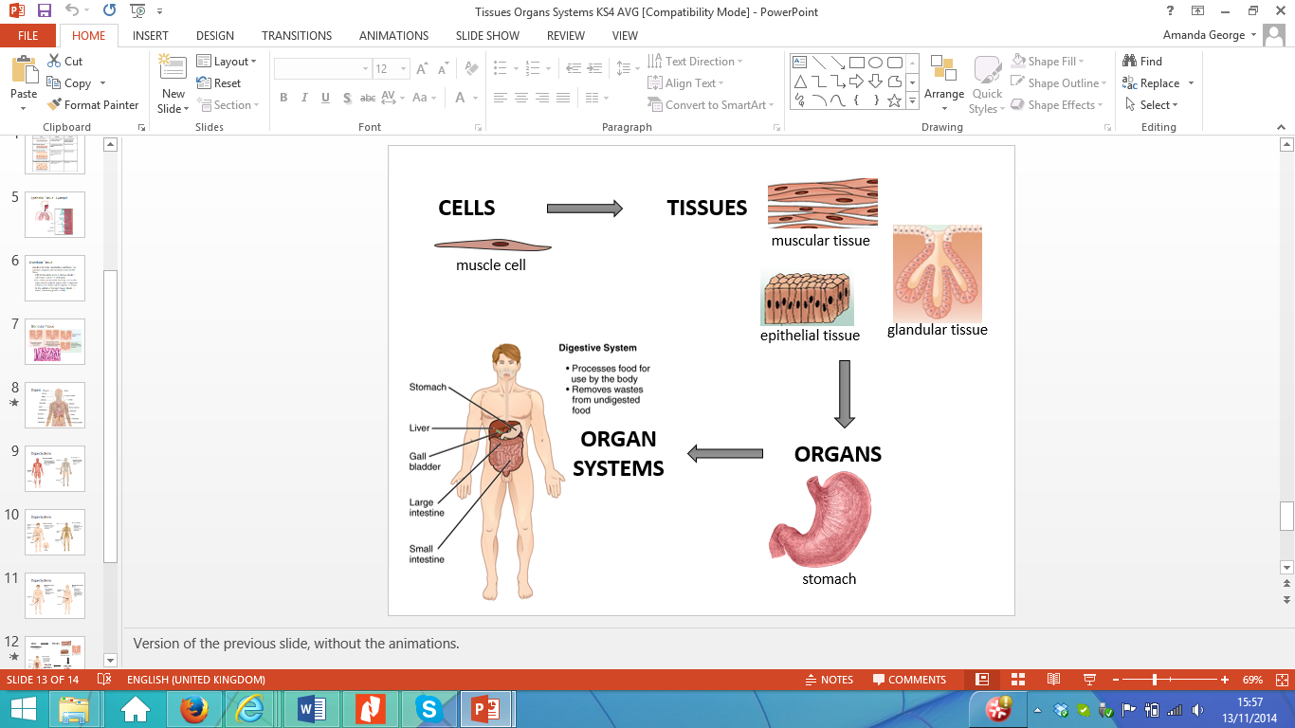
Concept Development
CFU 1
In an organism, what are tissues?
Cells → Tissues → Organs → Systems
Cells are the basic building blocks of life
Tissues are groups of cells with the same function
Organs are groups of tissues that work together
Systems are multiple organs working together to perform one or more of the 7 characteristics of living things
CFU 2
When groups of tissues work together, what are they called?
CFU 3
What is a system and what is its function?

Slide 4
Concept Development
Reminder
Move Respond Grow Reproduce Excrete waste Exchange gases Nutrition
CFU 1
Which of the 7 characteristics does the musculoskeletal system allow the human body to perform?
Organ Systems
Each organ system has one or more functions
One organ might belong to multiple systems
Digestive system – breaks down food for nutrients
Respiratory system – supplies the body with oxygen
Excretory system - removes waste from the body
Musculoskeletal system – gives the body structure and allows it to move.
Circulatory system – carries oxygen, nutrients and waste around the body
CFU 2
The stomach and intestines are part of which system?
CFU 3
Other than the excretory system, which other system is involved in excreting waste?

Slide 5
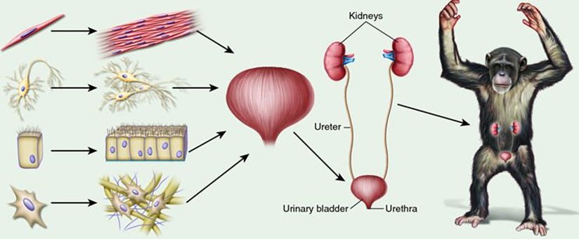
Skill Closure
Describe the difference between a tissue and a cell.
Skill Closure
In the flow chart, how many types of tissue are there in a bladder?
Skill Closure
One of the functions of the kidneys is to produce urine. Which body system are the kidneys part of? Explain your choice.
Body Systems
Digestive Respiratory Excretory Circulatory Musculoskeletal

Slide 6
Independent Practice
System | Organs in the system | Characteristics of living things this system links to
 | Mouth, stomach, intestines
 | Lungs, nose, trachea
 | Muscles, bones
 | Heart, veins, arteries
 | Kidneys, bladder, skin, lungs
 | Ovaries, penis, uterus, testes
 | Brain, eyes, ear, skin, nerves
Copy the table into your workbook or on your device.

Slide 7
The Digestive System

Slide 8
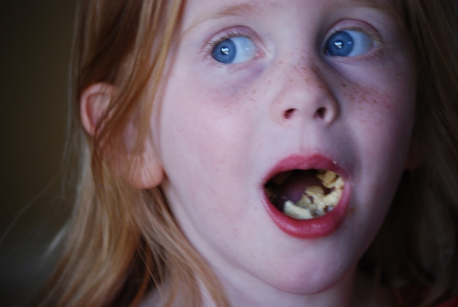
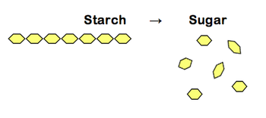
Concept Development
CFU 1
What is digestion?
What is the function of the digestive system
Digestion is the process of breaking down food and drink so their nutrients can be absorbed into the body.
There are two types of digestion:
Physical digestion is breaking down food into smaller pieces without changing the chemical structure of the food - for example chewing.
Chemical digestion uses chemicals (called enzymes) to break down the chemicals in the food – for example breaking starch down into smaller sugars.
CFU 2
What are the two types of digestion?
CFU 3
What are enzymes?
CFU 4
How is physical digestion different to chemical digestion?

Slide 9
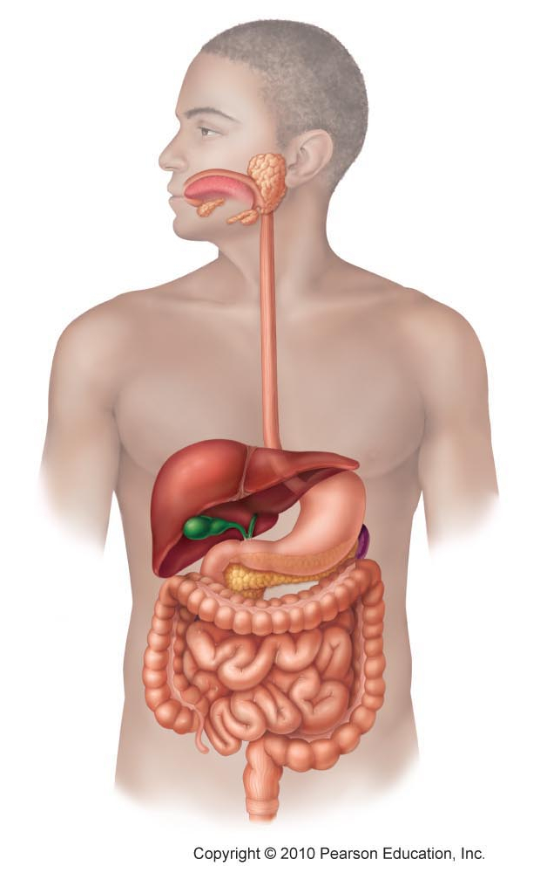
Concept Development
CFU 1
What is the digestive tract?
CFU 2
How does food get into the digestive tract?
The Digestive System – the digestive tract
Food passes through several organs as it is digested this is known as the digestive tract.
Food enters through the mouth
through the oesophagus and into the stomach
This empties into the small intestine
Then into the large intestine
Lastly, it is stored as faeces in the rectum before leaving the body through the anus.
Mouth
Oesophagus
Stomach
Small intestine
Large intestine
CFU 3
Which structure does food pass through to get from the mouth to the stomach?
CFU 5
What is stored in the rectum and how does it leave the body?
Rectum
CFU 4
Which part of the intestine does food go into first?
Anus
Vocabulary
Faeces: poo

Slide 10
Concept Development
CFU 1
What is the role of the liver and pancreas?
CFU 2
How does the gall bladder help the digestive process?
The Digestive System – the support organs
The liver and pancreas produce chemicals that help break down chemicals in the food.
The gall bladder stores chemicals produced by the liver.
Liver
Gall bladder
Pancreas
Vocabulary
Faeces: poo

Slide 11
Skill Development
CFU 1
What is the function of the mouth?
CFU 2
What role do teeth play in digestion?
Function of Organs in the Digestive System
Mouth - Food enters the system through the mouth, where teeth bite and grind food into smaller pieces.
Tongue - moves food around and pushes it down the oesophagus.
Mouth
CFU 3
What is the role of the tongue?
Oesophagus
Liver
Gall bladder
Stomach
Pancreas
Small intestine
Large intestine
Rectum
Anus

Slide 12
Skill Development
CFU 1
What is the function of the oesophagus?
CFU 2
How long is food stored in the stomach?
Function of Organs in the Digestive System
Oesophagus - moves food from the mouth to the stomach.
Stomach - food is mixed with stomach acid to help digestion.
Mouth
Oesophagus
Liver
Gall bladder
Stomach
Pancreas
Small intestine
Large intestine
CFU 3
What else happens in the stomach?
CFU 4
Where does the food go next?
Rectum
Anus

Slide 13
Skill Development
CFU 1
What is the function of the liver and pancreas?
CFU 2
Are the liver and pancreas involved in physical or chemical digestion? Explain your choice.
Function of Organs in the Digestive System
liver and pancreas - produce chemicals that are added to the food at the start of the small intestine to help break down the food
Gall Bladder – Stores bile made in the liver and adds it into the small intestine
Small intestine - Absorbs nutrients from food into the blood.
Mouth
Oesophagus
Liver
Gall bladder
Stomach
Pancreas
Small intestine
Large intestine
Rectum
Anus

Slide 14
Skill Development
CFU 1
What is removed by the large intestine?
CFU 2
What else does the large intestine do to the food?
Function of Organs in the Digestive System
large intestine - removes water from the food and compacts it into faeces.
Rectum - stores the faeces until it is released from the body.
Mouth
Oesophagus
Liver
Gall bladder
Stomach
Pancreas
Small intestine
Large intestine
CFU 3
How are the two intestines similar?
CFU 4
What happens in the rectum?
Rectum
Anus

Slide 15
Skill Closure
Put the organs of the digestive tract in the correct order.
Stomach, Small intestine, Mouth, Oesophagus, Large intestine, Anus, Rectum
Skill Closure
The liver and the pancreas are not part of the digestive tract, but have a role in digestion. What is their role?
Skill Closure
Harold says chewing is an example of chemical digestion. Is he correct? Explain your choice.

Slide 16
Comparing Digestive Systems

Slide 17
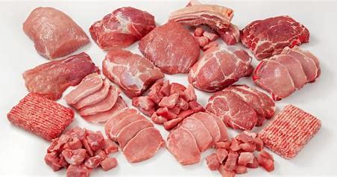
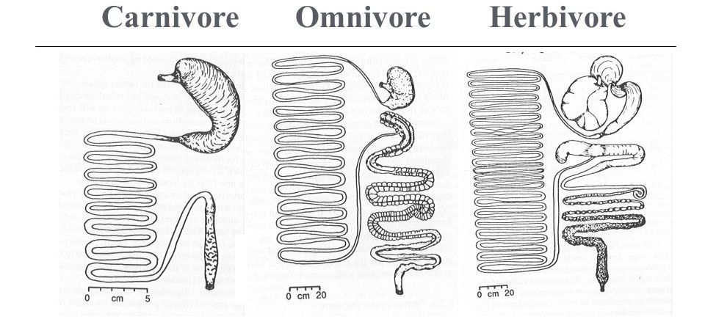
Concept Development
CFU 1
What makes up a carnivore’s diet?
Using Digestive Tract Length to Predict Diet
Carnivores eat meat, which is made of protein.
Proteins are easy to digest.
This means the digestive tracts of carnivores are short because protein is digested quickly.
CFU 2
True or False: Proteins are hard for the body to digest.
CFU 3
Why are carnivore digestive tracts short?
Vocabulary
Herbivores: eat plants Carnivores: eat meat Omnivores: eat meat and plants

Slide 18
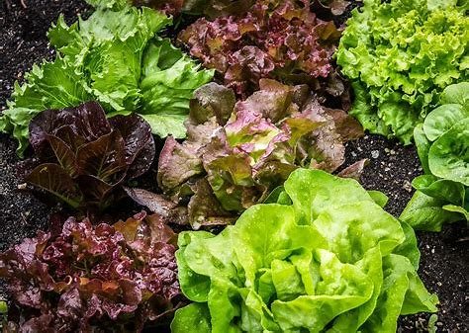
Concept Development
CFU 1
What make up a herbivore’s diet?
Using Digestive Tract to Predict Diet
Herbivores and omnivores eat plants as part of their diet.
Plant cells have cell walls made of cellulose, which is hard to digest.
This means the digestive tracts of herbivores and omnivores are long because it takes longer to break down their food.
CFU 2
Explain why plants are harder to digest.
CFU 3
What effect does cellulose in the diet have on the length of a digestive tract?
Vocabulary
Herbivores: eat plants Carnivores: eat meat Omnivores: eat meat and plants

Slide 19
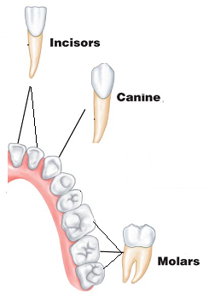
Concept Development
CFU 1
What are the three types of teeth?
Types of Teeth
There are different types of teeth, each with a particular function:
Incisors have a sharp edge and are used to cut through food.
Canines are pointed and used for ripping lumps of meat.
Molars are flat and are used for grinding.
CFU 2
How are molars different to incisors and canines?
CFU 3
How are canines and incisors similar?

Slide 20
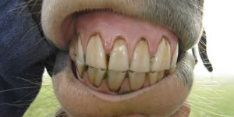
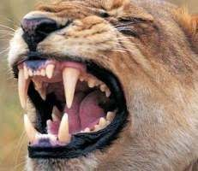
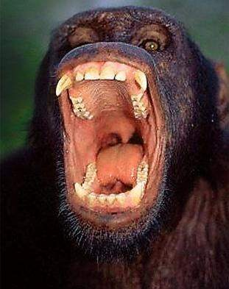
Concept Development
CFU 1
How are the diets of carnivores and herbivores different?
Using Teeth to Predict Diet
Herbivores have flat molars to grind their food so it can be digested more effectively by enzymes.
Carnivores have mostly incisors and canines to cut and tear meat.
Omnivores have a combination of all types of teeth, some for cutting and some for grinding.
CFU 2
Why do omnivores have three types of teeth?
CFU 3
A cow is a herbivore. What type of teeth would you expect it to have?
Vocabulary
Herbivores: eat plants Carnivores: eat meat Omnivores: eat meat and plants

Slide 21
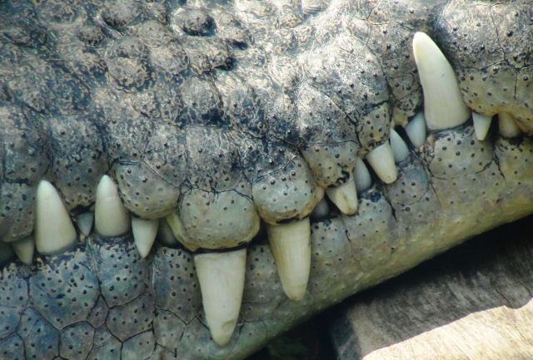
Skill Closure
How does the length of the digestive tract of a herbivore compare to that of a carnivore?
Skill Closure
There are three types of teeth - molars, incisors and canines. How is the function of a molar different to incisors and canines?
Skill Closure
Are these teeth from a herbivore or a carnivore? Explain your choice.

Slide 22
Problems with the Digestive System

Slide 23
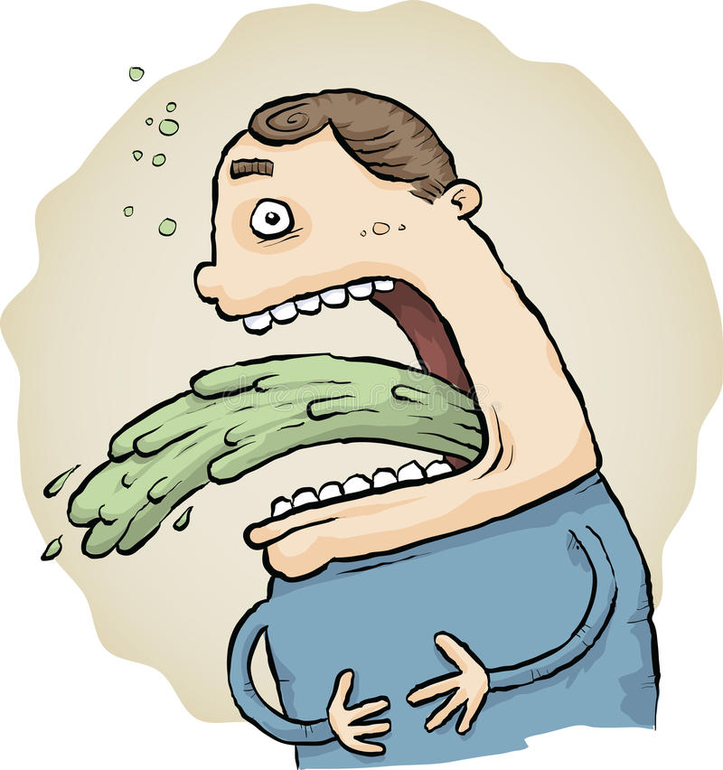
Vomiting: bringing up the contents of the stomach
Cause
Vomiting is a quick way of getting rid of unwanted bacteria in the upper digestive tract
The muscular walls of the stomach and small intestine contract, forcing the contents of the stomach up the oesophagus and out the mouth
Treatment
Drink clear fluids to remain hydrated, but small amounts at a time
Avoid solid food until vomiting stops and then eat light, bland food, such as crackers

Slide 24
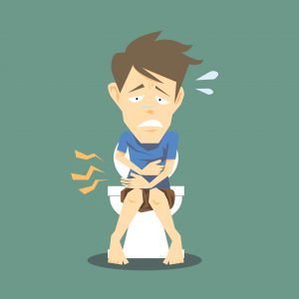
Diarrhoea: having frequent bowel movements with watery faeces
Cause
Diarrhoea is a quick way of getting rid of harmful bacteria in the lower digestive tract
The lining of the intestine becomes inflamed and can no longer absorb water from faeces
This results in watery faeces
Treatment
As the body is not absorbing water, people with diarrhoea are at risk of dehydration
Drinking plenty of fluids will prevent dehydration

Slide 25
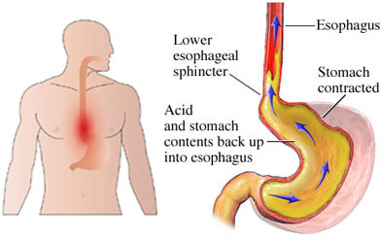
Heartburn: burning sensation in the chest
Cause
Heartburn is a burning sensation rising up from the stomach into the oesophagus
It is caused by stomach acid rising into the oesophagus
The stomach acid attacks the walls of the oesophagus because there is no mucus lining to protect it
Treatment
Antacids, in the form of liquids or tablets, are medications that neutralise stomach acid
Lifestyle changes, for example a change in diet, avoiding large meals and lying down after a meal can help persistent heartburn

Slide 26
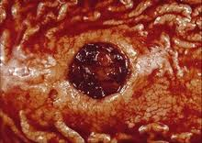
Stomach Ulcers: open sores in the stomach lining
Cause
The acid in the stomach eats away at the tissue around the ulcers causing pain
Two Australian scientists, Marshall and Warren, proved that ulcers are caused by a bacterium called Helicobacter pylori
Treatment
Stomach ulcers can be treated using antibiotics, which kill the bacteria that causes them
Before the discovery of the bacterium causing them, ulcers were treated by a change in diet or reducing stress

Slide 27
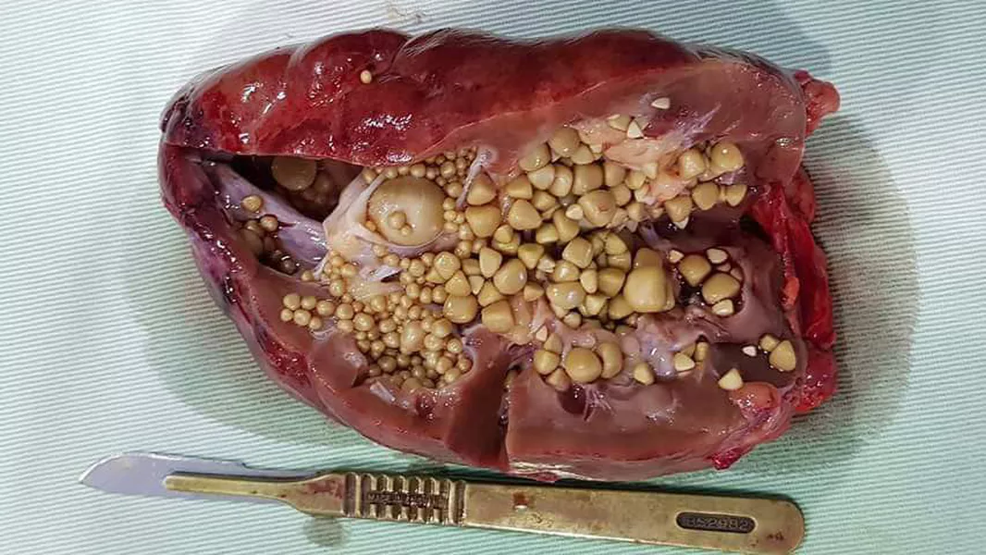
Gallstones: small masses in the gall bladder
Cause
The gall bladder stores bile produced by the liver
Bile can harden into small stones that stop the bile leaving the gall bladder.
This makes the gall bladder swell and causes pain
Treatment
Sometimes gall stones can be shattered using ultrasound or can be removed by surgery
Occasionally, the gall bladder is removed, but this means the person may have trouble digesting fats and oils

Slide 28
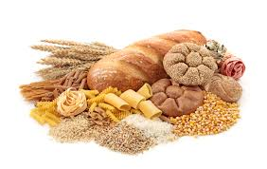
Gluten Intolerance: inability to process gluten in food
Cause
Gluten is a small molecule found in grains and cereals
Some people don’t produce the enzyme needed to chemically digest gluten
People who are gluten intolerant can have a range of problems, including blockage of the intestines, bloating and diarrhoea
Treatment
People who are gluten intolerant avoid foods containing gluten
Some people may also take dietary supplements containing the missing enzyme

Slide 29
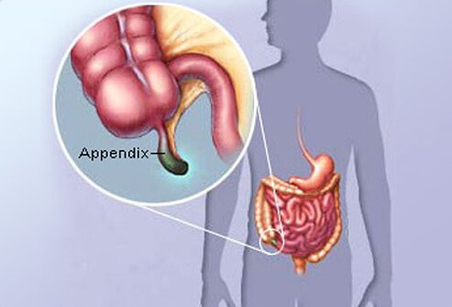
Appendicitis: an inflammation of the appendix
Cause
The appendix is a blind ended tube connected to the large intestine
If the opening gets blocked, it fills with mucus and becomes inflamed and swollen.
This inflammation can cause a lot of pain
Treatment
The only treatment is an operation to remove the inflamed appendix before it bursts and causes a more severe infection

Slide 30
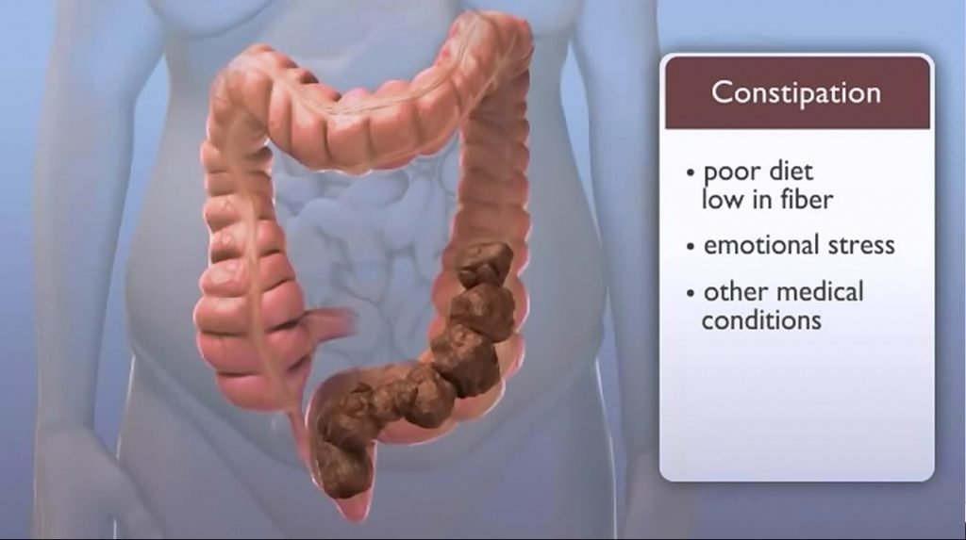
Constipation: blockages of the intestine
Cause
Blockages of the intestines can be caused by poor diet (lack of fruit and vegetables) or infections
Small blockages increase in size as more food moves through the digestive system, gradually filling the large intestine
This causes pain and discomfort
Treatment
A change in diet to include more fibre from fruit and vegetables can help prevent constipation
People can take laxatives, which are medications that help food move through the intestines easily
For large or prolonged blockages, surgery may be needed to remove the blockage

Slide 31
The Respiratory System

Slide 32
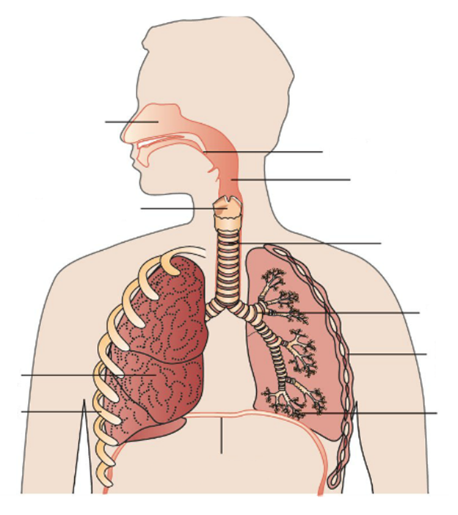
Concept Development
CFU 1
What is the respiratory tract?
CFU 2
How does air get into the respiratory system?
The Respiratory System – Respiratory Tract
The respiratory tract is the path the air passes through within the body.
Air is inhaled into the nasal cavity through the nostrils.
Air then goes through the pharynx and larynx (voice box), and down the trachea.
Nasal cavity
Pharynx
Larynx
Trachea
CFU 3
Which two organs does air go through before it reaches the trachea?
Vocabulary
Inhale: breathe in Exhale: breathe out

Slide 33
Concept Development
CFU 1
When the trachea splits, what does it become?
CFU 2
How are bronchioles different to the bronchi?
The Respiratory System – Respiratory Tract
The trachea splits into two bronchi (plural), which enter the lungs.
In the lungs, each bronchus (singular) splits into smaller and smaller tubes, called bronchioles.
Air sacs called alveoli are at the ends of each bronchiole.
Nasal cavity
Pharynx
Larynx
Trachea
Bronchus
Lung
Alveoli
CFU 3
What are at the ends of each bronchiole?
Vocabulary
Inhale: breathe in Exhale: breathe out

Slide 34
Concept Development
CFU 1
What is the epiglottis?
The Respiratory System – Support Organs
The epiglottis is a flap of cartilage at the back of the throat. It stops food entering the trachea and closes over when we swallow.
Nasal cavity
Epiglottis
Pharynx
Larynx
Trachea
Bronchus
Intercostal Muscles
Lung
Ribs
Alveoli
Diaphragm
Vocabulary
Inhale: breathe in Exhale: breathe out

Slide 35
Skill Development
CFU 1
What is the function of the nasal cavity?
CFU 2
How is the function of the pharynx, trachea and bronchi similar?
The Function of Organs in the Respiratory System
The nasal cavity warms and moistens the air.
The pharynx, trachea and bronchi carry air into the lungs.
Air passing through the larynx allows you to speak.
CFU 3
What could you not do without the larynx?
Nasal cavity
Epiglottis
Pharynx
Larynx
Trachea
Bronchus
Intercostal Muscles
Lung
Ribs
Alveoli
Diaphragm
Vocabulary
Inhale: breathe in Exhale: breathe out

Slide 36
Skill Closure
Put the organs of the respiratory tract in the correct order.
Bronchiole, nasal cavity, alveoli, trachea, pharynx, bronchus
Skill Closure
The intercostal muscles and the diaphragm are not part of the respiratory tract, but have a role in breathing. What is their role?
Skill Closure
What role do the alveoli and blood vessels play in the respiratory system?

Slide 37
Breathing and Gas Exchange

Slide 38
Concept Development
CFU 1
What forms a cage around the lungs?
The Respiratory System – Support Organs
The ribs form a protective cage around the lungs.
The intercostal muscles are muscles between the ribs that help us breathe.
The diaphragm is a sheet of muscle that is attached to the ribs.
Nasal cavity
Epiglottis
Pharynx
Larynx
Trachea
Bronchus
Intercostal Muscles
Lung
Ribs
Alveoli
CFU 2
Where would you find intercostal muscles?
CFU 3
What is the diaphragm?
Diaphragm
Vocabulary
Inhale: breathe in Exhale: breathe out

Slide 39
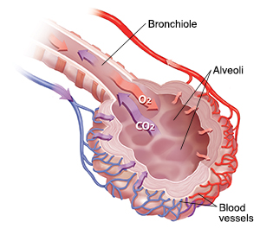
Skill Development
CFU 1
What is the function of the alveoli?
CFU 2
What surrounds each alveolus?
CFU 3
What role does blood play in gas exchange?
The Function of Organs in the Respiratory System
The alveoli exchange oxygen and carbon dioxide.
They are surrounded by a mesh of tiny blood vessels.
Oxygen moves into the blood and carbon dioxide moves out of the blood.
Vocabulary
Inhale: breathe in Exhale: breathe out

Slide 40
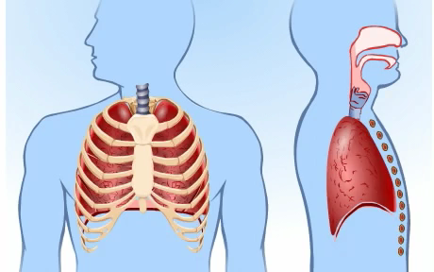
Skill Development
CFU 1
Why are the lungs unable to move on their own?
CFU 2
Which muscles work together to allow the body to breathe?
Breathing
The lungs have no muscles, so cannot move on their own.
Breathing occurs when the diaphragm and intercostal muscles work together.
The muscles contract to expand the chest and draw air into the lungs.
When the muscles relax, the chest deflates and pushes air out of the lungs.
CFU 3
How is the body able to move air into and out of the lungs?
Vocabulary
Inhale: breathe in Exhale: breathe out

Slide 41
Problems with the Respiratory System

Slide 42
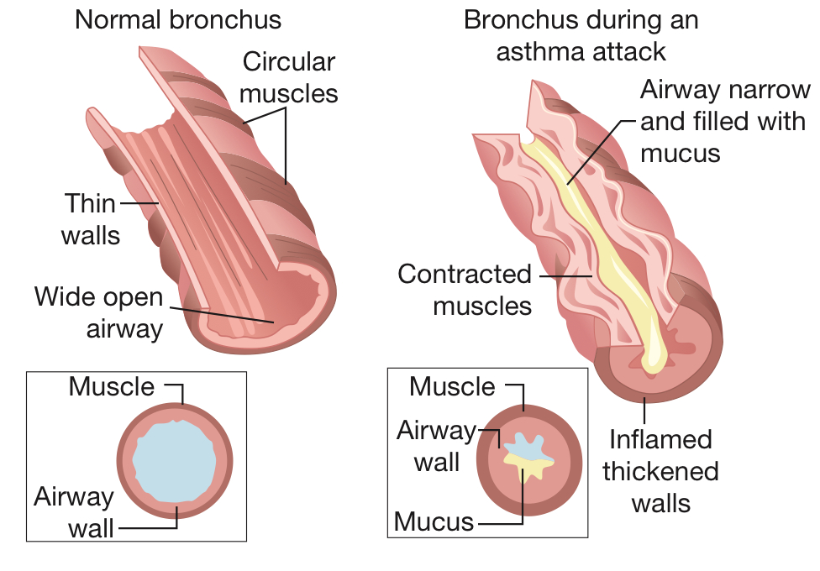
Asthma
Asthma is a chronic disease in which the bronchi in the lungs are swollen and tender. In this condition the bronchi react to factors in the environment, known as triggers. Triggers such as tobacco smoke, dust and pollens cause muscles in the walls of the bronchi to contract, making the airways narrow, as shown in Figure 3.1.1. The cell lining of the bronchi produces extra mucus. The mucus reduces the space inside the bronchi even more and the person has difficulty breathing.
When people with asthma feel an attack coming on, they use puffers. The puffer contains chemicals that relax the muscles of the bronchi. This allows the bronchi to open up and the person is able to breathe freely again.

Slide 43
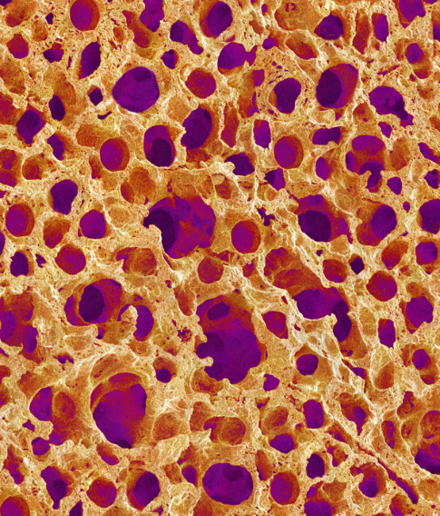
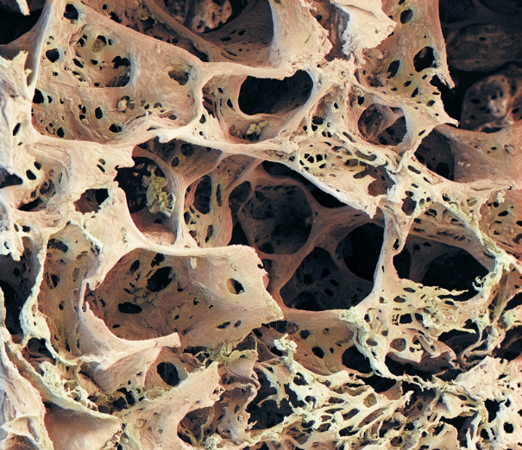
Emphysema
Emphysema is a chronic lung disease in which the bronchi, alveoli and blood capillaries are damaged. Emphysema is usually caused by smoking or long-term exposure to air pollutants (chemicals) and dust.
The tissues of healthy bronchi and alveoli are elastic, which means that they are able to stretch and then return to their original shape. When bronchi and alveoli are exposed to pollutants and dust over long periods of time, they lose their ability to stretch. The bronchi become narrow and the alveoli break. Damage to the alveoli creates larger spaces within the lungs. Having large spaces reduces the surface area for gas exchange. The blood capillaries surrounding the alveoli are also damaged and less carbon dioxide and oxygen can be carried to the alveoli and away from them.
Alveoli of someone suffering from emphysema Alveoli of a healthy person.
People with emphysema become breathless during physical activity and frequently have chest infections. They often have a bluish colour to their skin, especially around their lips. This bluish colour is known as cyanosis and is caused by a lack of oxygen in their blood.
Emphysema develops slowly. Damaged alveoli and tissues of the bronchi do not repair themselves so the damage is permanent. A person with advanced emphysema has to breathe hard in an attempt to exhale fully and to get enough air into their lungs. Open your mouth as wide as it can go and then try blowing out a candle or match without making an ‘O’ shape with your lips. It is difficult. This is what breathing is like for people with emphysema, all the time.

